Slide 1
Linear Programming

Slide 2
Concept of LP
It is a mathematical technique, which involves the allocation of limited resources in an optimal manner on the basis of given criterion of optimality.
It deals with the optimization of a function of variables known as objective functions and subject to a set of linear equalities and/or inequalities known as constraints.

Slide 3
Formulation of LP Problems
The process of mathematical formulation of LP problem involves the following steps:
  Write down the decision variables of the problem.
  Formulate the objective function to be optimized as a linear function of the decision variables.
  Formulate other conditions of the problem as linear equations or inequations in terms of decision variables.
  Add the non-negativity constraint to avoid the negative values of the decision variables.
Note: The objective function, the set of constraints and the non-negative constraints together form an LP problem.

Slide 4
General Formulation of LP Problem
The steps involved in the general formulation of an LP problem are:
  Maximizing or minimizing the objective function Z by finding the values of ‘n’ decision variables x1,x2,….,xn.
  Z = c1x1 + c2x2 + ….+ cnxn
  Satisfying the m-constraints imposed on the problem.
  a11x1+a12x2+….+a1nxn(≤ = ≥) b1
  a21x1+a22x2+….+a2nxn(≤ = ≥) b2
  :
  ai1x1+ai2x2+….+ainxn(≤ = ≥) bi
  :
  am1x1+am2x2+….+amnxn (≤ = ≥) bm
  They should also satisfy the non negative restrictions, x1≥0, x2≥0,….,xn≥0.

Slide 5
Matrix Form of LP Problem
The LP problem can be expressed in the matrix form as:
  Maximize or minimize the objective function, Z = Cx subject to Ax (≤=≥) b constraint equation and b>0, x≥0 non-negativity restrictions where
    x = (x1,x2,….,xn)
    c = (c1,c2,….,cn)

Slide 6
Graphical Method

Slide 7
Objectives
Understand the procedure of solving LPP by graphical method
Understand the important definitions associated with graphical method
Understand the standard and canonical form of LPP

Slide 8
Procedure of Solving LPP By Graphical Method
Graphical method can solve LPP having only two decision variables.
The steps involved in the process of solving LPP by graphical method include:
  Replace the inequalities of the constraints with the “=” sign.
  Find the values of two variables by giving an arbitrary value to one variable and then finding the value of another by solving the equation.
  Plot the values ascertained in step two on graph and join the two points to form a straight line for each constraint.

Slide 9
Procedure of Solving LPP By Graphical Method (Contd..)
  Identify and mark the feasible region or the common region after placing all the equations on the graph:
    If the inequality constraint is “ ≤”, then the region below that line will be marked.
    If the inequality constraint is “ ≥”, then the region above that line will be marked.
  Find the maximum and minimum values using corner point method and putting the values of corner points in the objective function.
  Consider the optimal solution of that corner point at which the profit is highest in case of maximisation and cost is lowest in case of minimisation problem among all the points.

Slide 10
Some Important Definitions
Solution: A set of values X1,X2…Xn that satisfies the constraints of the LPP.
Feasible solution: Any solution to a LPP, which satisfies the non-negativity restrictions of the LPP.
Optimum solution: Any feasible solution that optimizes the objective function of the LPP.
Basic variables: In a system of m linear equations with n variables (m<n), any solution which is obtained by solving for m variables keeping the n–m variables zero is called basic solution. Such m variables are called basic variables and the remaining variables are called non-basic variables.
Unbounded solution: A solution which can increase or decrease the value of the objective function of the LPP indefinitely.

Slide 11
Some Important Definitions (Contd..)
Basic feasible solution: A basic solution that also satisfies non-negativity restrictions. It is of two types:
  Non-degenerate: It is a solution in which none of the basic variable is zero.
  Degenerate: It is a solution in which one or more basic variables are zero.
Slack variable: A variable which is added to the left-hand side of “≤” constraint to convert it into a equation.
Surplus variable: A variable which is added to the right-hand side of “≥” constraint to convert it into a equation.

Slide 12
Standard and Canonical Form of LPP
Standard form of LPP: This form involves the following characteristics:
  All constraints are expressed as equations irrespective of whether to maximize or minimize the objective function.
  All the variables of the equations are non-negative.
  All the values at right hand side of constraints are non-negative.
Canonical form of LPP: This form involves the following characteristics:
  If the objective function is of maximization then all the constraints are of “≤” type.
  If the objective function is of minimization then all the constraints are of “≥” type.
  Note: There is no affect of maximization and minimization on the non-negative constraints, they are always greater than equal to zero.

Slide 13
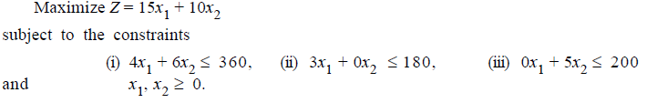
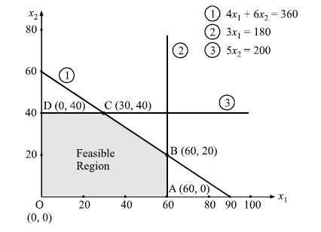
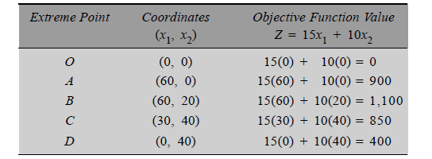
Use the graphical method to solve the following LP problem.

Slide 14
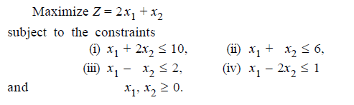
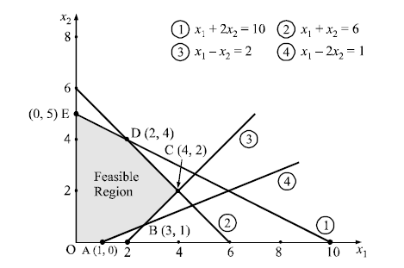
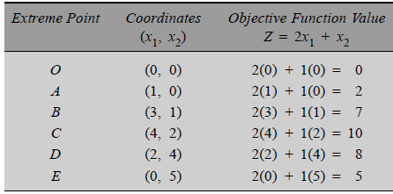

Slide 15
Simplex Method

Slide 16
Objectives
Understand the concept of simplex method
Understand the definitions of simplex method
Understand the algorithm of simplex method

Slide 17
Simplex Method
It is an iterative method for solving LPP in a finite number of steps.
It involves moving from one vertex of the region of feasible solution to another such that the value of objective function at the succeeding vertex is less or more than at the previous vertex.
It leads to an optimal vertex or indicates the existence of unbounded solution.

Slide 18
Definitions of Simplex Method
Definition 1:
  Let X_{B} be the basic feasible solution to the LPP.
  Max Z = C_{X} subject to A_{X} = b and X≥0 such that it
  satisfies X_{B} = B⁻¹ b where B is the basis matrix formed by
  the column of basic variables.
  The vector C_{B} = ( C_{B1}, C_{B2},….C_{Bm}) where C_{Bj} are
  components of C associated with the basic variables is
  called the cost vector associated with the basic feasible
  solution X_{B}.

Slide 19
Definition of Simplex Method (Contd..)
Definition 2:
  Let X_{B} be the basic feasible solution to the LPP. Max Z = C_{X} subject to A_{X} = b and X≥0.Let C_{B} be the cost vector corresponding to X_{B}. For each column vector a_{j} in A₁, which is not a column vector of B, let
    Then the number
    is called the evaluation corresponding to a_{j} and the
    number (Z_{j} - C_{j}) is called the net evaluation
    corresponding to j.

Slide 20
Algorithm for Simplex Method
To find the solution of any LPP by simplex method, an initial basic feasible solution is always assumed.
The algorithm for simplex method involves the following steps to compute the optimum solution:
  Check whether the objective function of the given LPP is to maximized or minimized.
    If it is to be minimized, convert it into a problem of maximization as Min Z = Max (-Z).
  Check whether all bi (i=1,2…m) are positive.
    If any one of bi is negative then multiply the inequation of the constraint by -1 so as all bi’s are positive.
  Introduce slack or surplus variables to inequality constraints to convert them into equations.

Slide 21
Algorithm for Simplex Method (cont..)
  Find an initial basic feasible solution to the problem in the form X=B⁻¹ b and put it in the first column of the simplex table.
  Calculate the net evaluations Z_{j}-C_{j} by using the relation Z_{j}-C_{j}= C_{B}(a_{j}-c_{j}).
    If all Z_{j}-C_{j}≥0, then the initial basic feasible solution XB is the optimum solution.
    If at least one Z_{j}-C_{j}>0, then proceed to the next step as the solution is not optimal.

Slide 22
Simplex Algorithm (contd..)
  If there are more than one negative Z_{j}-C_{j}, choose the most negative one. Let it be Z_{r}-C_{r} for some j=r. This gives the entering variable X_{r} and if there are more than the one variable having same most negative Z_{j}-C_{j} select any one of them as the entering variable.
    If all X_{ir}≤0 (i=1,2…m) then there is an unbounded solution to the given problem.
    If at least one X_{ir}>0 (i=1,2…m) then the corresponding vector X_{r} enters the basis.
  Compute the ratio (X_{Bi}/X_{kr}, X_{ir}>0). If the minimum of these ratios be X_{Bi}/X_{kr}, then choose the variable X_{k} to leave the basis called the key row and the element at the intersection of key row and key column is called key element.

Slide 23
Simplex Algorithm (contd..)
  Form a new basis by dropping the leaving variable and introducing the entering variable along with associated value C_{B} column.
  Divide the key equation by the key element to convert the leading element to unity and convert all other elements in its column to zero by using the following formula:
    New element = old element- [Product of elements in key row and key column / key element]
  Go to step 5 and repeat the method until either optimum solution is obtained or there is an indication of unbounded solution.

